Slide 1
Large-Scale Industrial Control Software The IEC 61499 Standard
Roopak Sinha

Slide 2
Agenda
Distributed Systems (Industrial)
IEC 61499 Function Blocks Architecture

Slide 3
Related Learning Outcomes
Understand the key factors and critically assess the issues that come into play in the development of large-scale software systems.
Independently select or design architectures for complex software systems and clearly document non-trivial software architectures.
Critically evaluate different software architectures and analyse their advantages and disadvantages.

Slide 4
Where are we in the course?
Until now (part 1):
Software Architecture
Various factors/contexts/variables.
Fundamentals.
From now on (part 2):
Specific architectures and standards
IoT
IEC 61499
IEC/IEEE/ACM 42010
Guest lecture
Reinforcing what we have learnt in part 1

Slide 5
Questions
What is a distributed system?
What is an industrial distributed system?
What are the main stakeholder concerns in such systems?

Slide 6
Definitions of Distributed Systems
“A system that consists of a collection of two or more independent computers which coordinate their processing through the exchange of synchronous or asynchronous message passing.”
“A distributed system is a collection of independent computers that appear to the users of the system as a single computer.” [A. Tannenbaum]
Notes:
Air Collision Avoidance System:
US Border Control in Canada
Stock Exchange Market

Slide 7
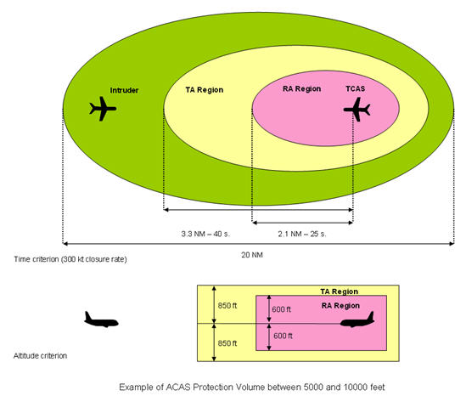
ACAS
Is it a Distributed Application?

Slide 8
Deployment of Distributed Applications
Nodes
Sites
Some code is running
Some code is running
Communication channel(s)
Some code is running
Notes:
SMS delivery application
- Operates in the cell phone network infrastructure
- HW:
Can it work via Bluetooth and Wi-Fi ? What needs to be done?

Slide 9
Reasons for Distribution
Exam question
Functional distribution
Load distribution
Replication of processing power
Economics
Add value
Redundancy
Flexibility

Slide 10
Challenges of Distribution
Exam question
Concurrency
Absence of global notion of time or state
Sharing of resources
Fault tolerance
Reconfigurability
Distributed algorithm design

Slide 11
Topologies/Patterns
Exam question
Client-server
P2P
Mediators

Slide 12
Programming of Distributed Systems
Traditional programming languages + communication API
Specific distributed languages
ADA - military applications
Erlang - Ericsson
Haskell - Functional programming
Oz -
Have structures simplifying implementation of typical tasks, such as concurrency/parallelism, data/signal exchange, synchronisation
Architecture description languages

Slide 13
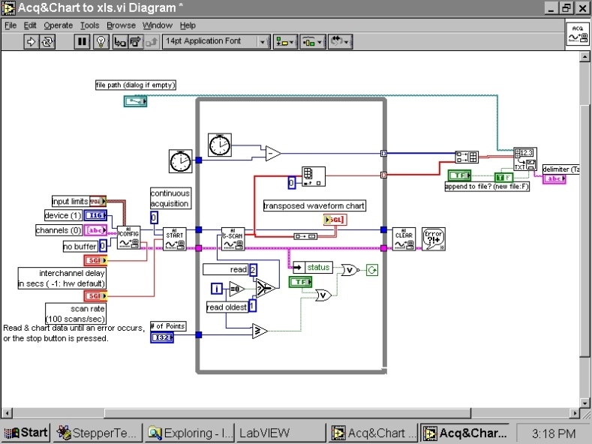
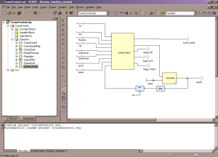
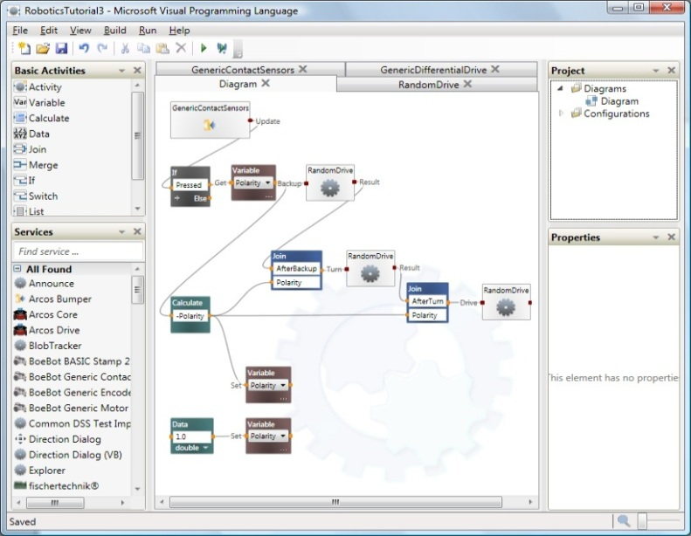
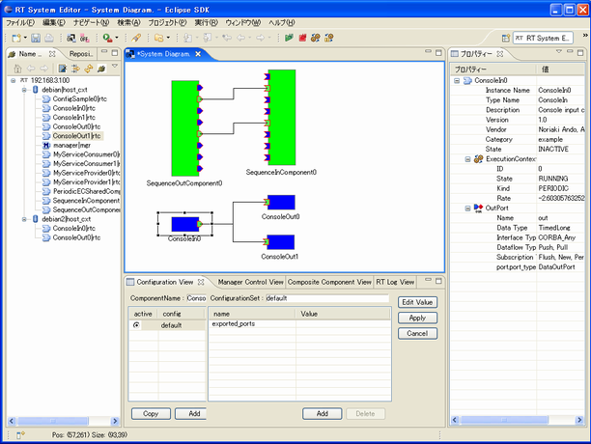
Block Diagram-based Programming
LabView
SCADE
Microsoft Visual Programming Language
Open RTM

Slide 14
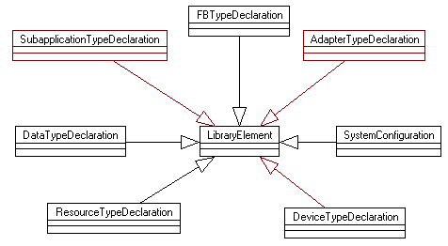
Function Blocks Architecture
Exam question
The Function Blocks architecture is intended for distributed measurement and control systems. Its artefacts:
Basic FBType
Composite FBType
SIFBType

Slide 15

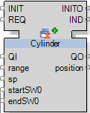
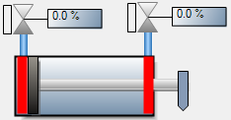
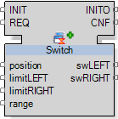
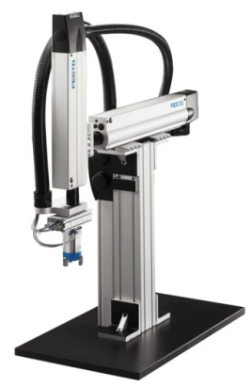
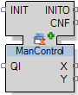
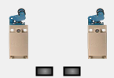
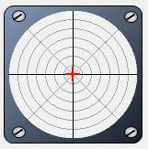
Modular Software for Modular Machines
Function Block = event driven component

Slide 16
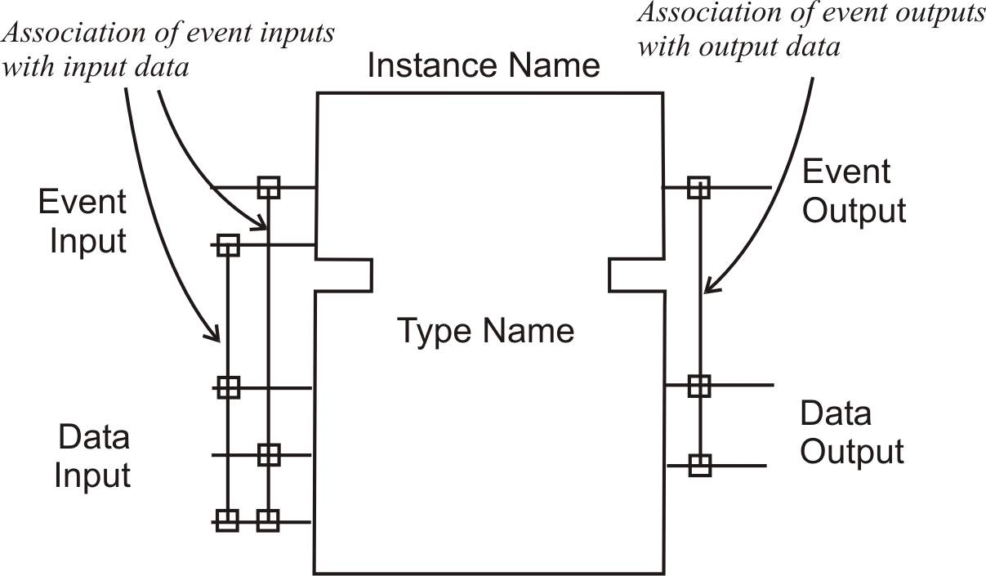
Function Block Interface
Exam question
Notes:
Reuse mechanism: Typing – Instantiation

Slide 17
What is Event ?

Slide 18
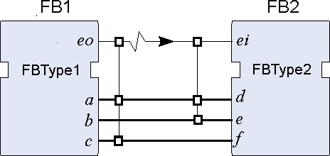
Event-driven Data Exchange
Event/data association is a part of FB Type definition
Call ei (d, e, f) where:
d= actual value of a e= old value of b f= old value of c

Slide 19
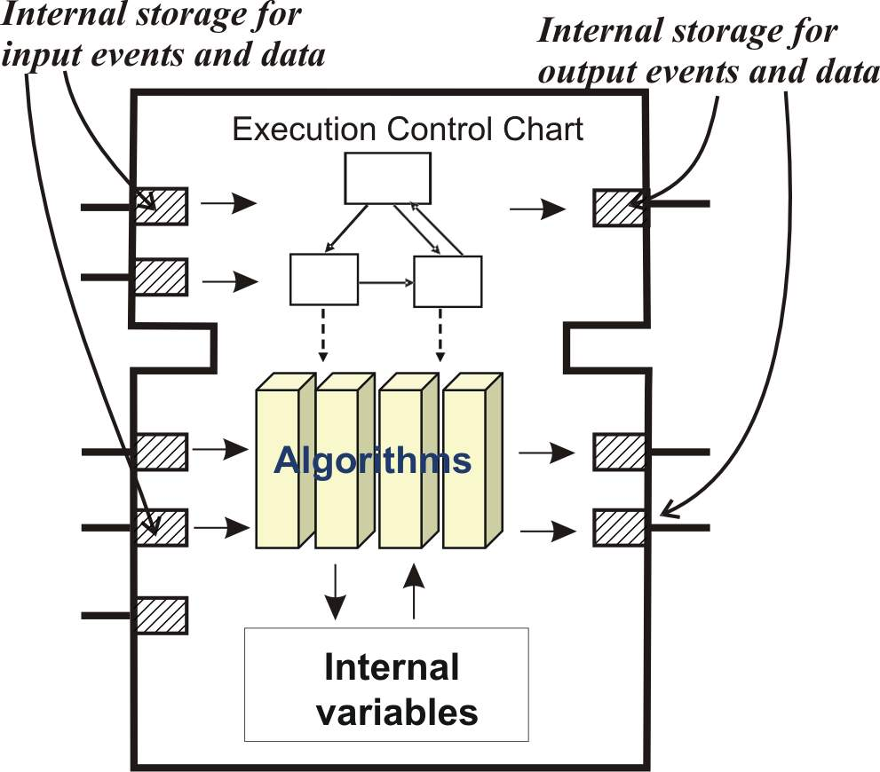
Basic Function Block

Slide 20
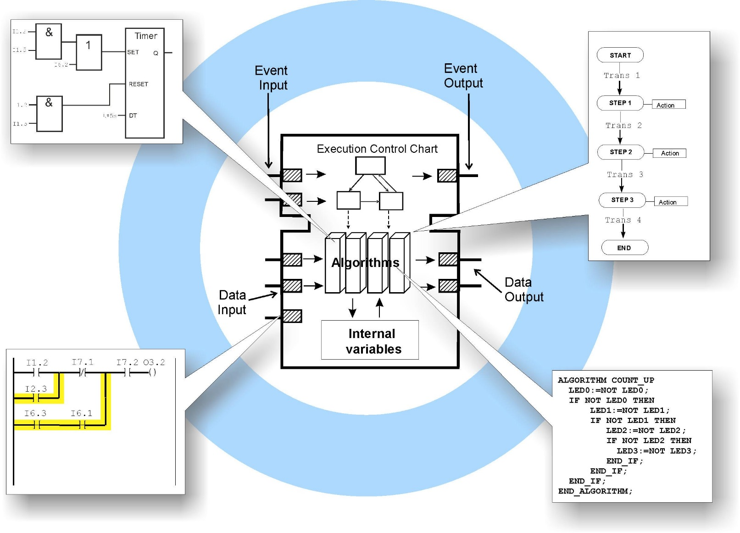
Encapsulation of legacy code

Slide 21
Execution model – event driven
Exam question
EVENT
INIT
INITO
EVENT
EVENT
REQ
CNF
EVENT
0
LOGIC
1
BOOL
QI
RES1
BOOL
2
1
INT
PARAMS
RES2
BOOL
BOOL
A
BOOL
B
BOOL
C
SHUT
SHUT
CNF
REQ & (PARAMS=2)OR(QI=0)
ACTIVE:=0
RES1:=0 RES2:=NOT B
1
START
1
REQ&(PARAMS=1)&ACTIVE
A
B
RES1
INIT
] [
] [
( )
1
C
]/[
INIT
INIT
INITO
MAIN
MAIN
CNF
A
B
RES2
] [
] [
( )
ACTIVE:=1
RES1:=0 RES2:=0
RES1
]/[

Slide 22
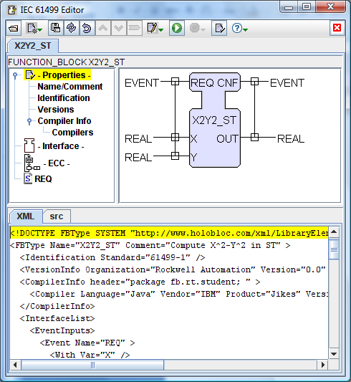
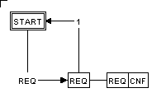
Example: Basic Function Block
ALGORITHM REQ IN ST
OUT := (X-Y)*(X+Y);
END

Slide 23
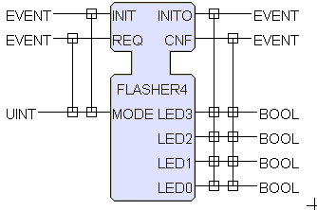
Function Block Model

Slide 24
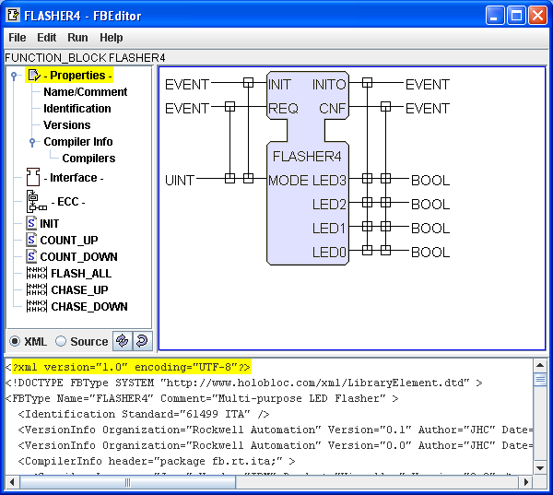
Basic FB: FLASHER4

Slide 25
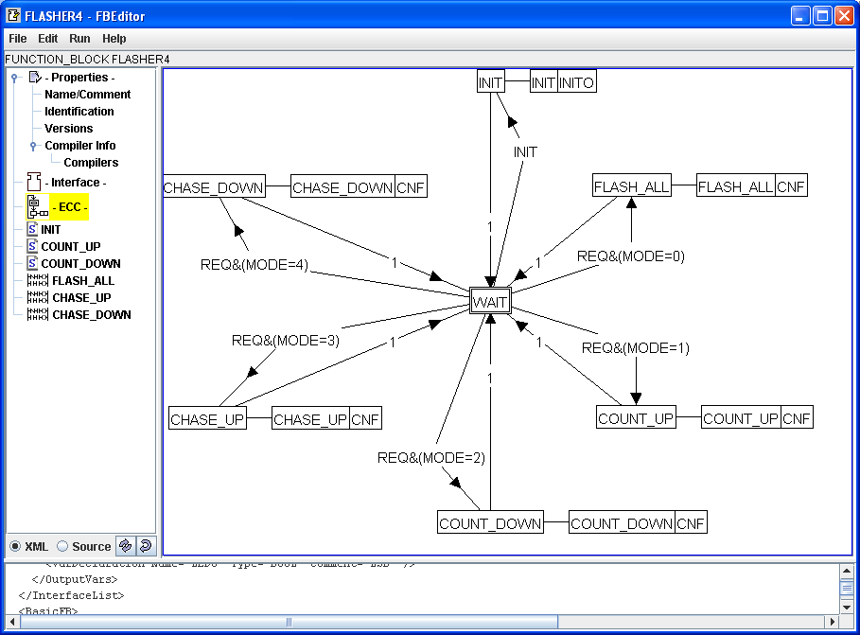
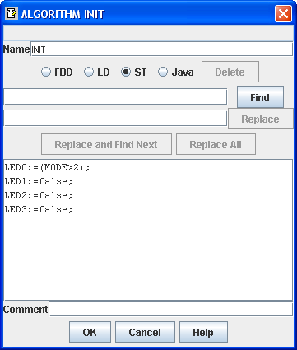
Execution Control Chart and Algorithms

Slide 26
Syntax of transition conditions
Event
Expression over Data
Event & Expression over Data

Slide 27
Exercise
Exam question
Create a basic function block (multiplexer):
Event in: REQ, event out: RESP
Input variables: IN1 (integer), IN2 (integer), Choice (Boolean)
Output variable: OUT (integer)
Functionality (ECC):
Everytime REQ comes in, sample all input variables, then:
If Choice is false, assign OUT=IN1, emit RESP
If Choice is true, assign OUT=IN2, emit RESP

Slide 28
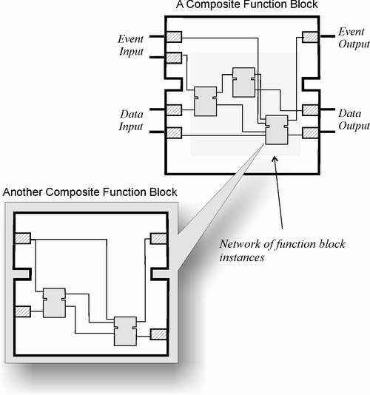
Composition

Slide 29
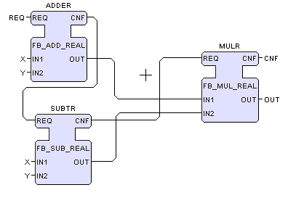
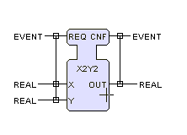
Example: calculate X²-Y² using composite FB
Notes:
Make composite blocks !

Slide 30
Application logic: Event and Data connections of FBs
Exam question
Event flow
Data flow

Slide 31
Connections
E_SPLIT

Slide 32
Connections
E_MERGE

Slide 33
Quick Recap
Exam question
Event flow
Data flow
Function Blocks (IEC 61499):
A reference architecture for distributed measurement and control systems
Offers an implementable model which copes well with modern component approaches
Supports familiar (for control engineers) block diagram look and way of thinking
Notes:
Is not a programming language!

Slide 34
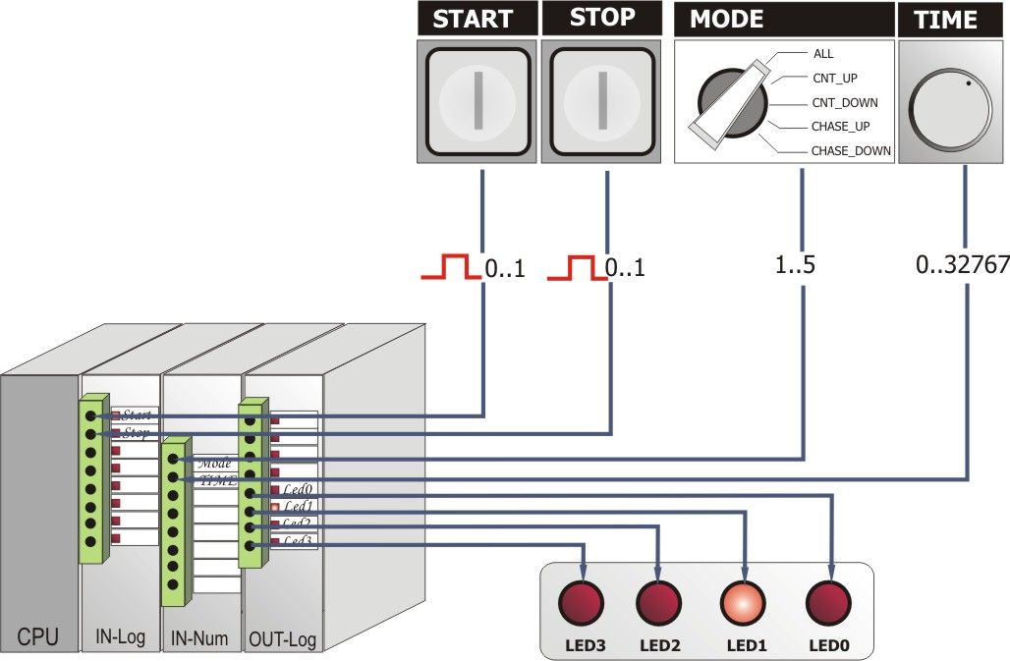
A Flasher Application

Slide 35
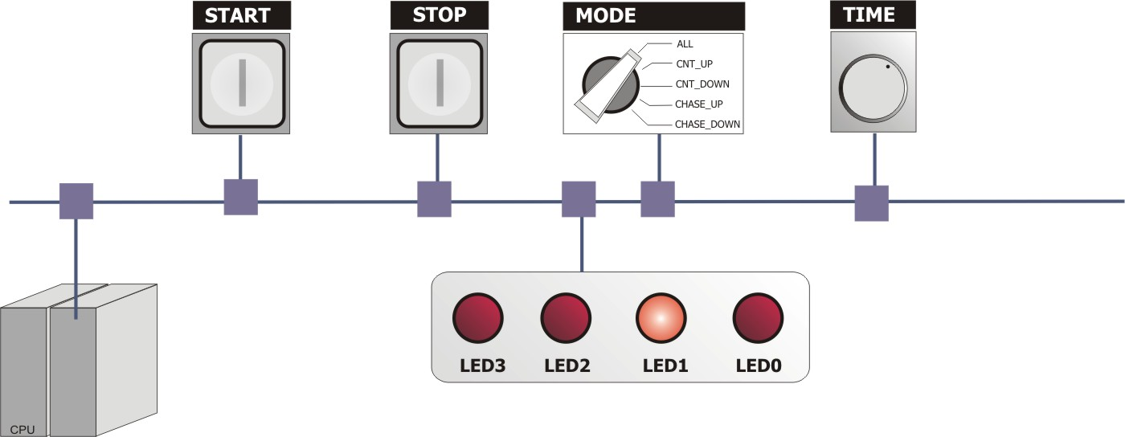
Motivation: Distributed architecture

Slide 36
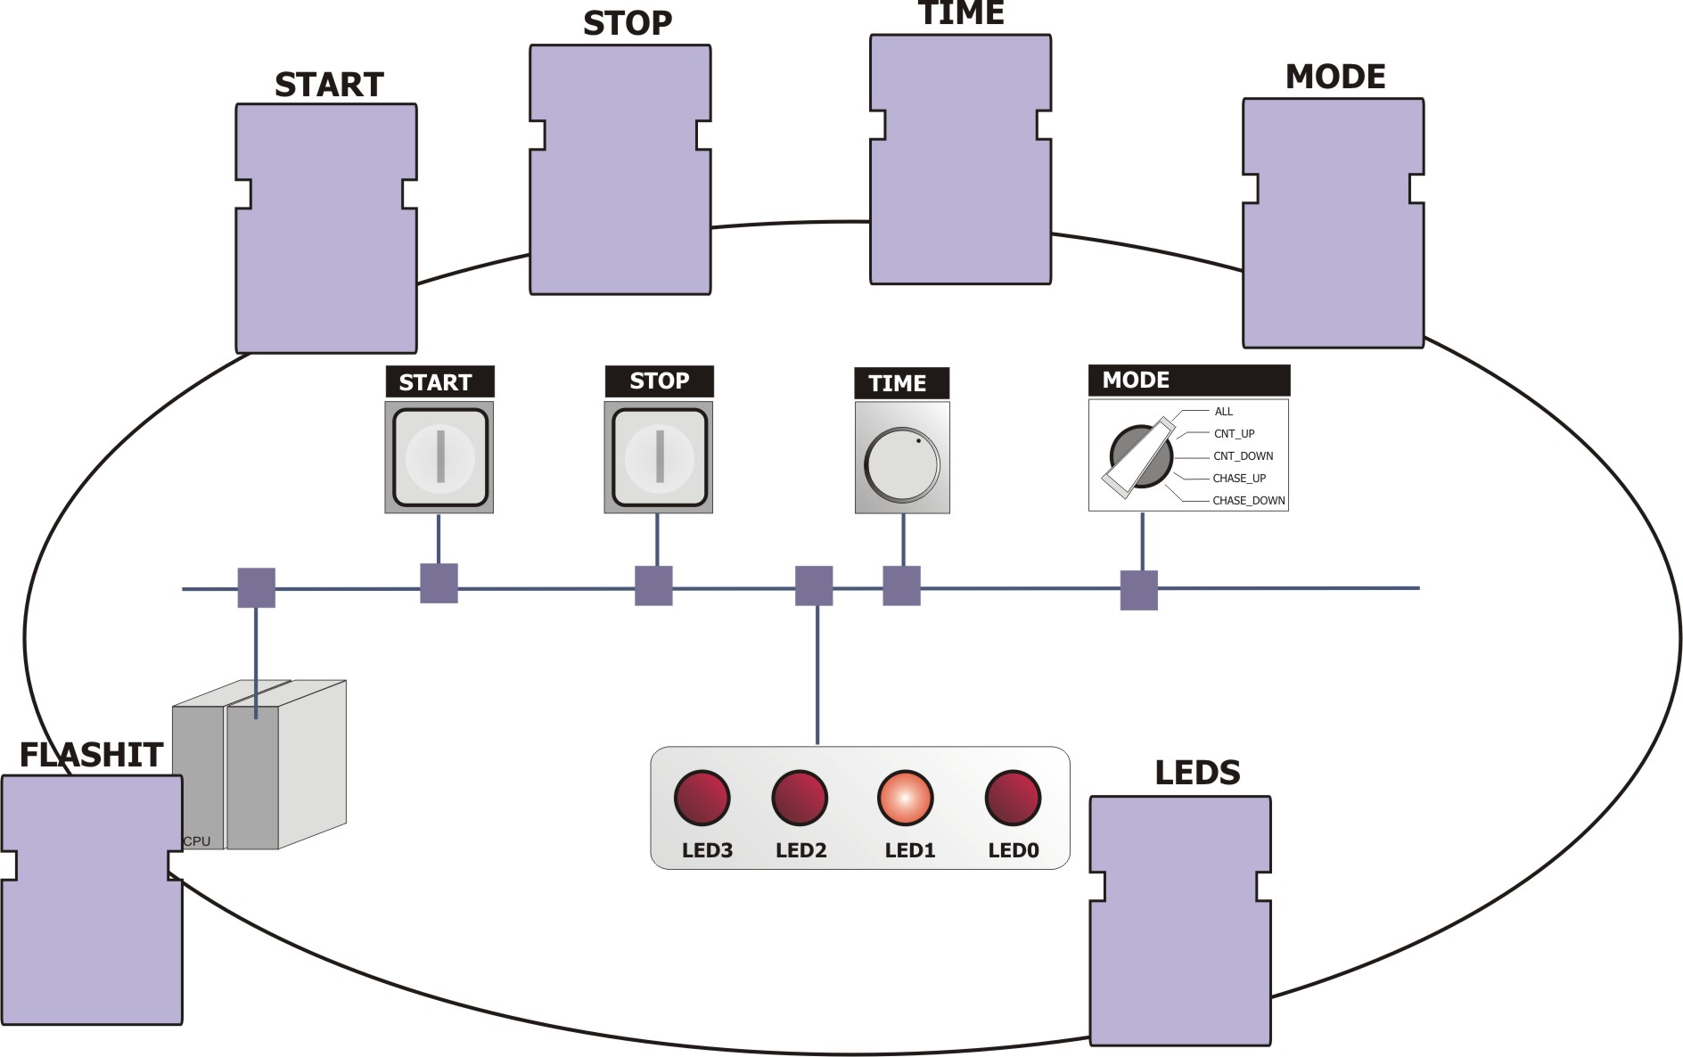
Distributing Functionality

Slide 37
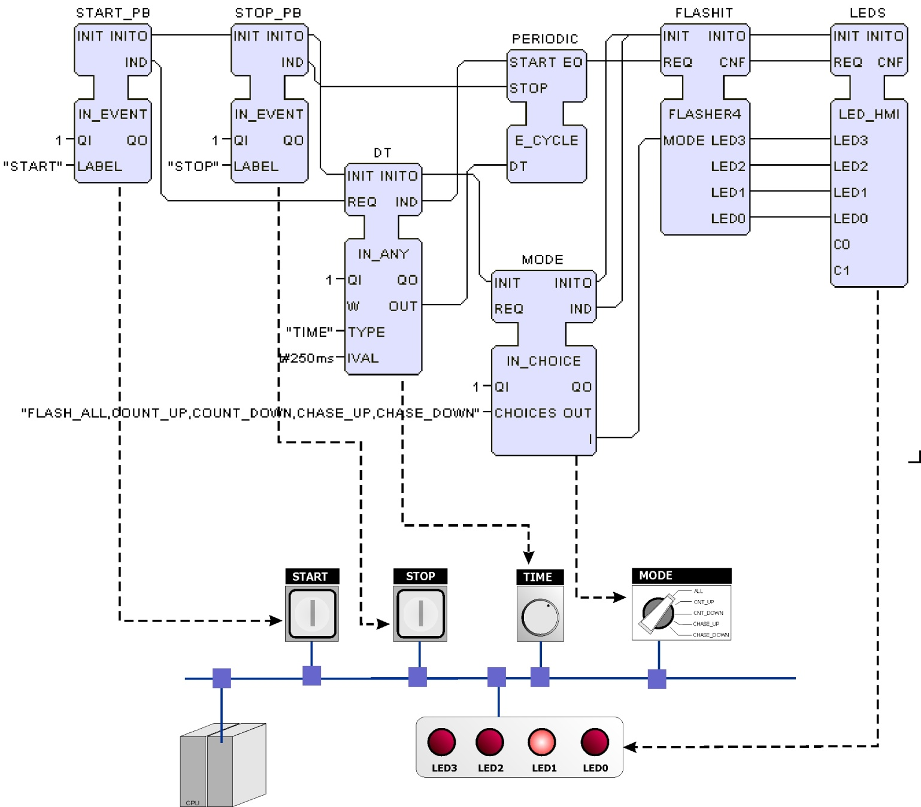
Implementing functions

Slide 38
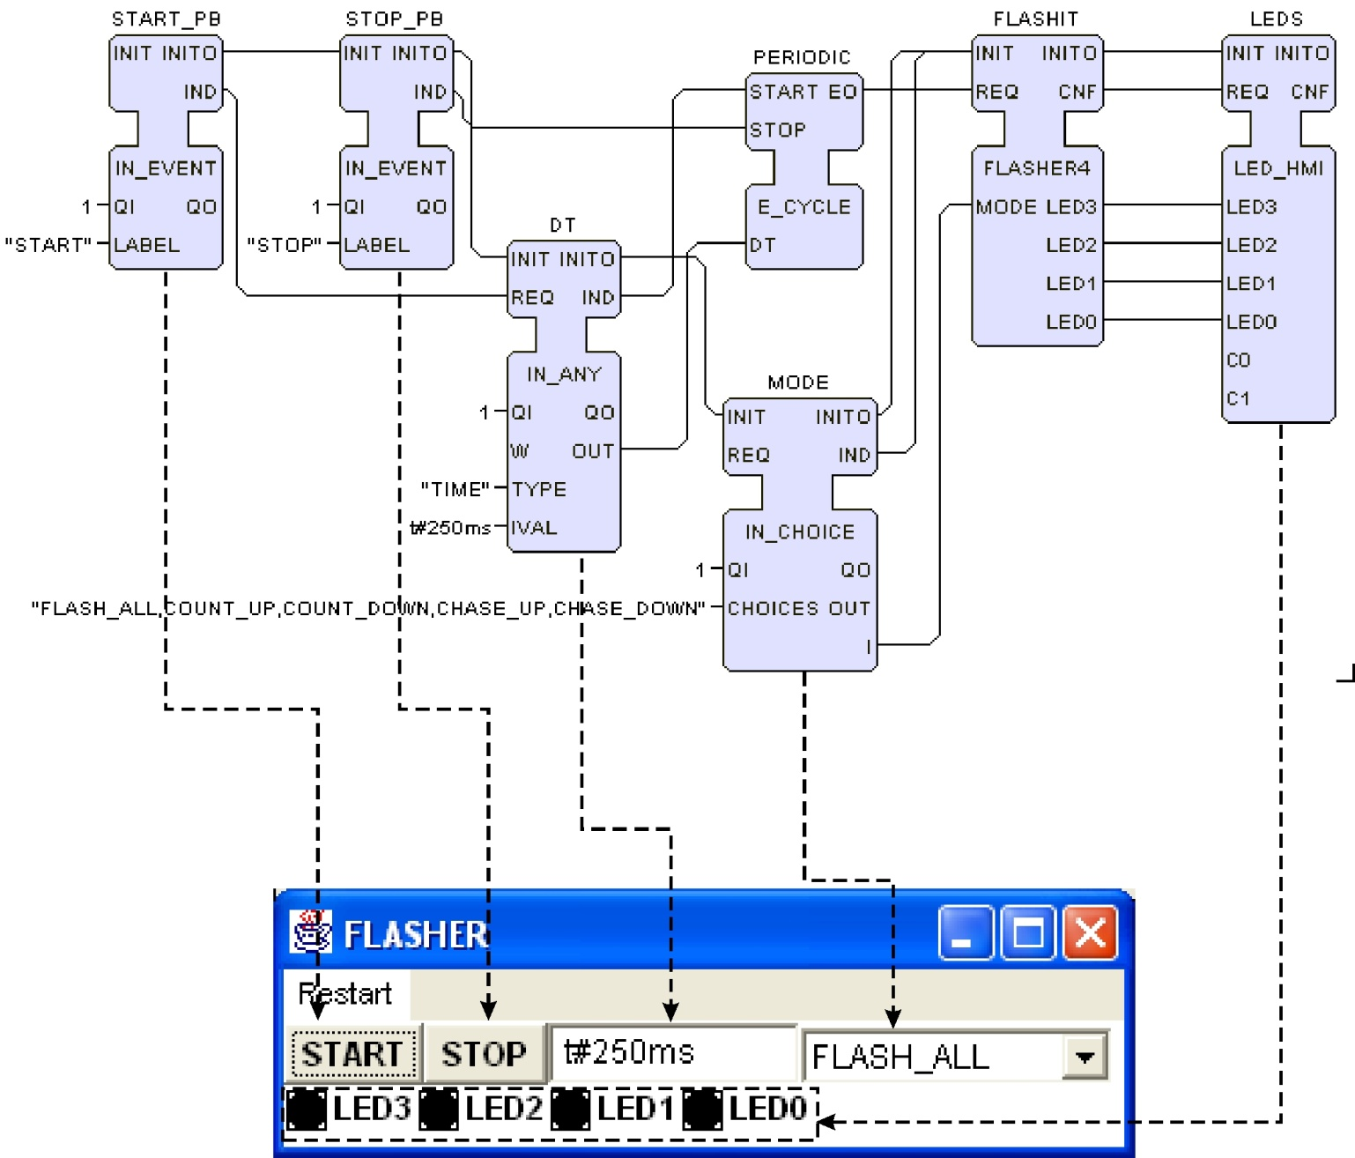
Simulation

Slide 39
Two device topology

Slide 40
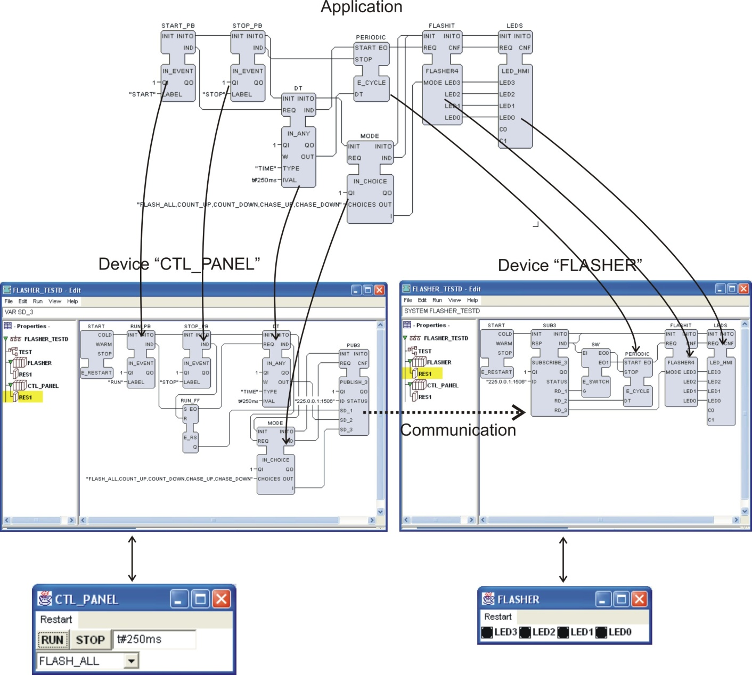
Mapping onto two devices

Slide 41
Three device topology

Slide 42
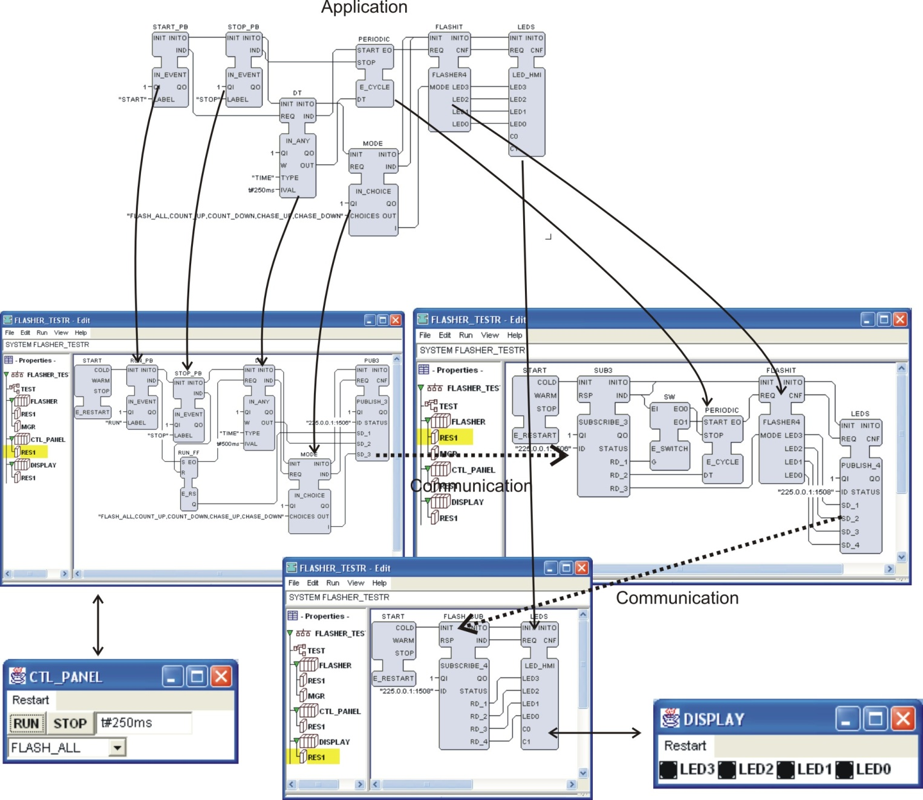
Distribution onto three devices

Slide 43
Distribution Model
Exam question
Event flow
Application =
Function Block Network
Data flow
Communication network
Device 1
Device 2
Device 3
Device 4
System = Communication Network + Devices +
Process/Machines
Application A
Appl. C
Application B
Controlled process/machines
Notes:
__________________________________________________________________________
__________________________________________________________________________
__________________________________________________________________________
__________________________________________________________________________
__________________________________________________________________________
__________________________________________________________________________
__________________________________________________________________________
__________________________________________________________________________
__________________________________________________________________________
__________________________________________________________________________

Slide 44
Device Model
Device = Container for Resources
Device provides Communications & Process Interfaces
Communication link(s)
Device boundary
Communication interface(s)
Resource x
Resource y
Resource z
Application A
Application C
Application B
Process interface(s)
Controlled process/machine
Notes:
__________________________________________________________________________
__________________________________________________________________________
__________________________________________________________________________
__________________________________________________________________________
__________________________________________________________________________
__________________________________________________________________________
__________________________________________________________________________
__________________________________________________________________________
__________________________________________________________________________
__________________________________________________________________________

Slide 45
Resource Model
Resource schedules & executes FB algorithms
Resource maps Communications & Process I/O Functions to Service Interface Function Blocks
Communication functions
Communication mapping
Local application
(or local part of distributed application)
Events
Service
Data
Service
Interface
Algorithms
Interface
Function
Function
Block
Block
Process mapping
Process I/O functions
Scheduling Function
Notes:
__________________________________________________________________________
__________________________________________________________________________
__________________________________________________________________________
__________________________________________________________________________
__________________________________________________________________________
__________________________________________________________________________
__________________________________________________________________________
__________________________________________________________________________
__________________________________________________________________________
__________________________________________________________________________

Slide 46
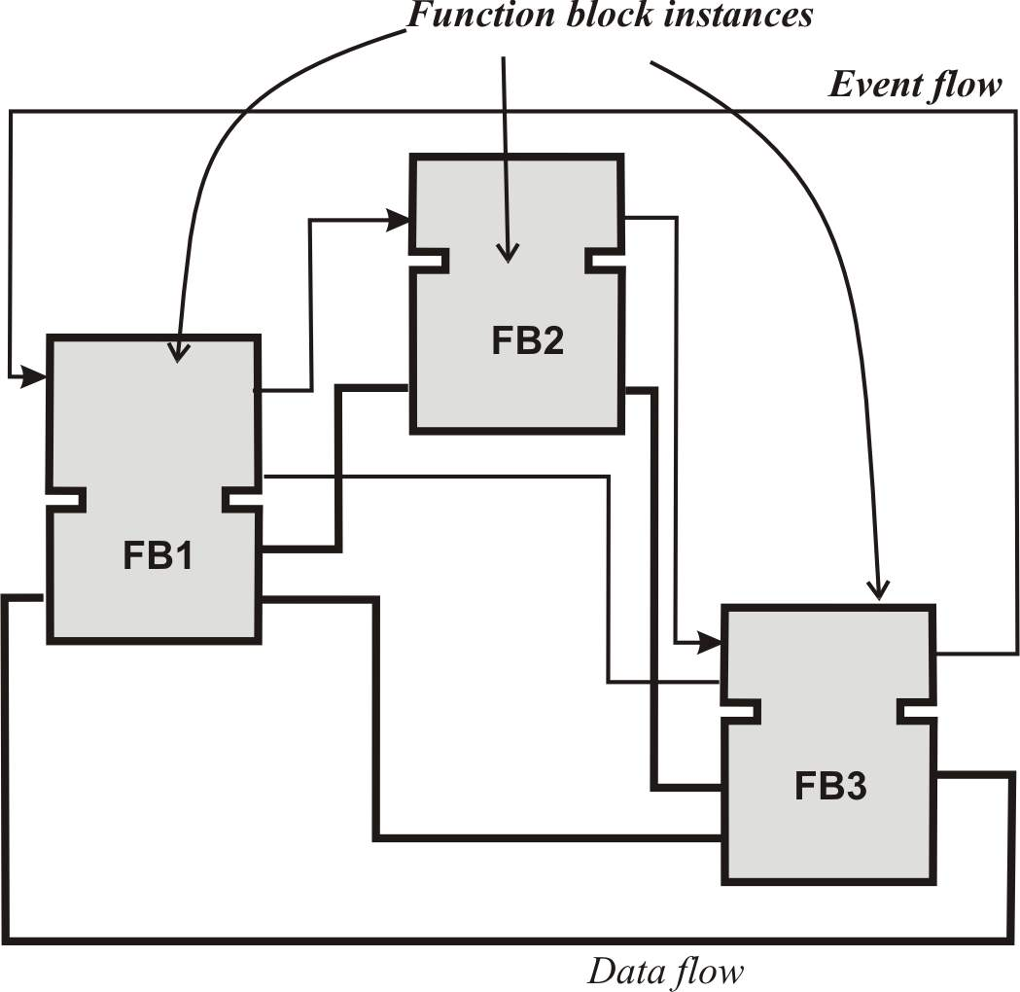
Application

Slide 47
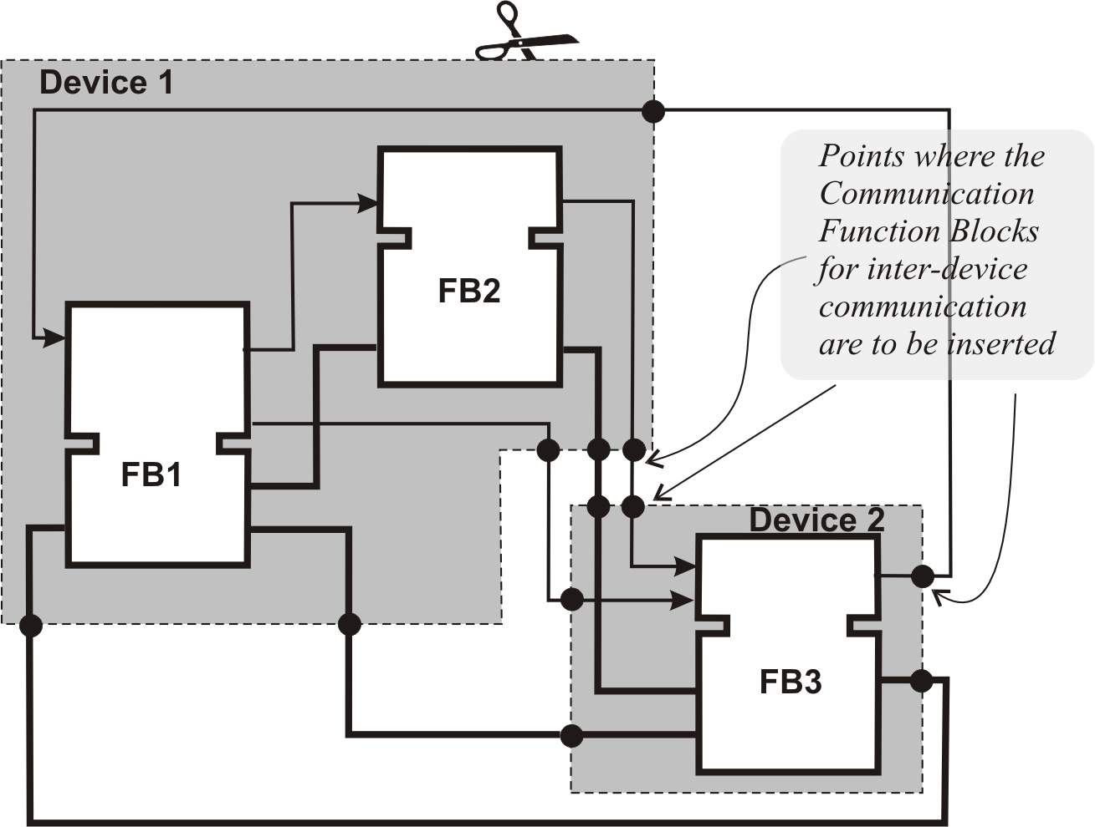
Distribution

Slide 48

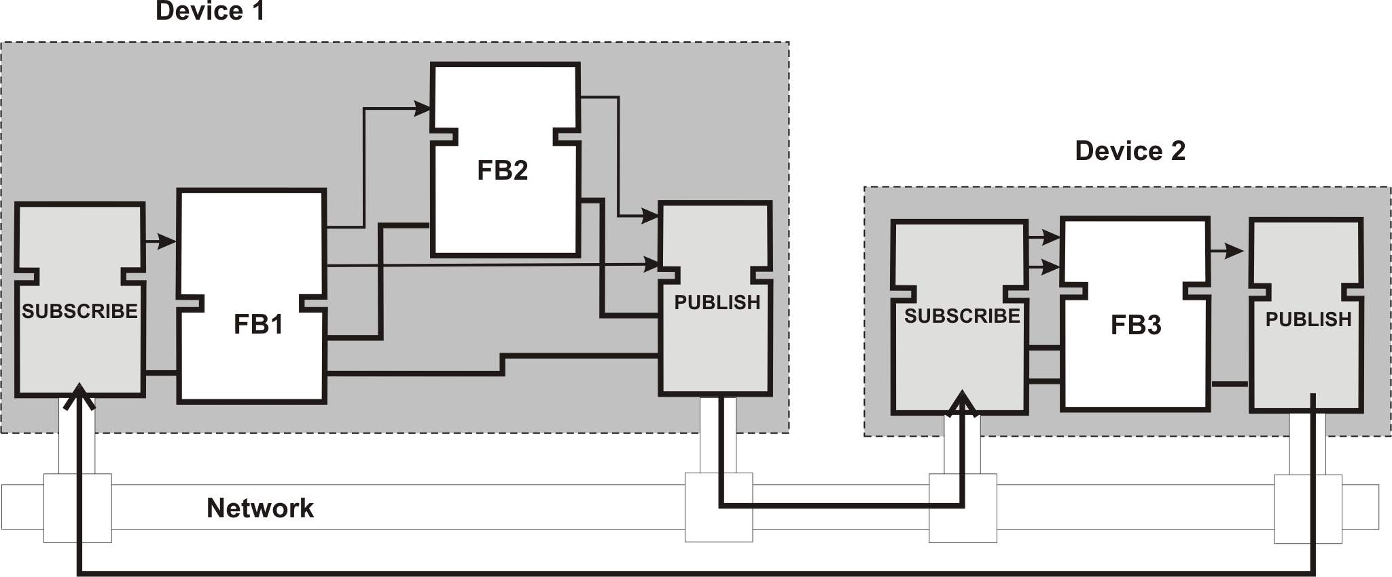
Mapping onto Devices/Resources

Slide 49
Communication Models
Publish/Subscribe Model:
INIT
INITO
INIT
INITO
REQ
CNF
RSP
IND
FB_PUBLISH
FB_SUBSCRIBE
QI
QO
QI
QO
PARAMS
STATUS
PARAMS
STATUS
SD_1
RD_1
:
:
SD_m
RD_m
Client/Server Model:
EVENT
INIT
INITO
EVENT
EVENT
REQ
CNF
EVENT
EVENT
INIT
INITO
EVENT
FB_CLIENT
EVENT
RSP
IND
EVENT
BOOL
QI
QO
BOOL
ANY
PARAMS
STATUS
ANY
INIT(+)
FB_SERVER
ANY
SD_1
RD_1
ANY
PARAMS
BOOL
QI
QO
BOOL
:
:
:
:
INIT(+)
INITO(+)
ANY
PARAMS
STATUS
FB_CNXN_STATUS
ANY
SD_m
RD_n
ANY
PARAMS
ANY
SD_1
RD_1
ANY
INITO(+)
:
:
:
:
ANY
SD_n
RD_m
ANY
REQ(+)
SD_1, ..., SD_m
IND(+)
RD_1, ..., RD_m
RSP(+)
CNF(+)
SD_1, ..., SD_n
RD_1, ..., RD_n

Slide 50
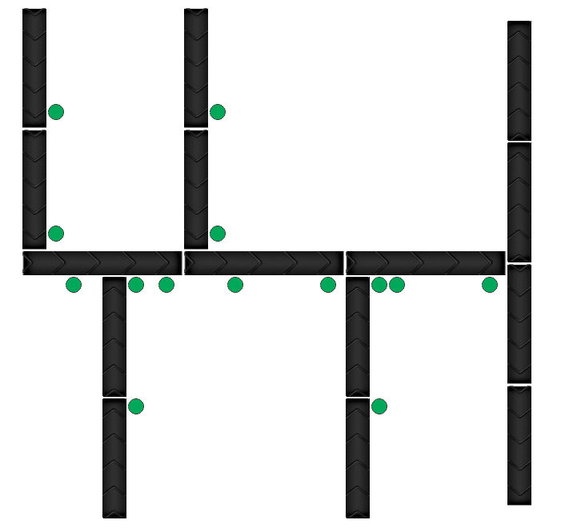
Discussion
Let’s architect an airport baggage handling system
4 entry points
3 exit points
Several PhotoEyes
Several merges/joins
One separator

Slide 51
Question
Exam question
Is IEC 61499 Architecture, a subset of the IoT reference architecture?

Slide 52
Homework
Install FBDK and try to make an application
http://www.holobloc.com/doc/fbdk/
Read the IEC 61499 architecture description
AUTonline -> Library -> Electronic Reserves -> Example Architectures
Apply the concepts from lectures 1-6 in this context.

